Slide 1


EduMind – AI Student Counseling Chatbot
CONTENTS
CerebroX
1. Problem Statement
2. Our Solution
3. Key Features
4. How It Works (User Journey)
5. AI Integration
6. UI/UX Design Preview
Team leader : Yash vishwakarma
2nd member : toheed khan
3rd member : Abu fahad
7. Impact & Scalability
8. Tech Stack

Slide 2

CONTENTS
1. Problem Statement
2. Our Solution
3. Key Features
4. How It Works (User Journey)
5. AI Integration
6. UI/UX Design Preview
7. Impact & Scalability
8. Tech Stack

Slide 3


Problem Statement
Key Issues Students Face
High academic stress & exam pressure
Anxiety, depression, and low motivation
Limited access to professional counselors
Social stigma around seeking help
Lack of continuous guidance & follow-ups

Slide 4
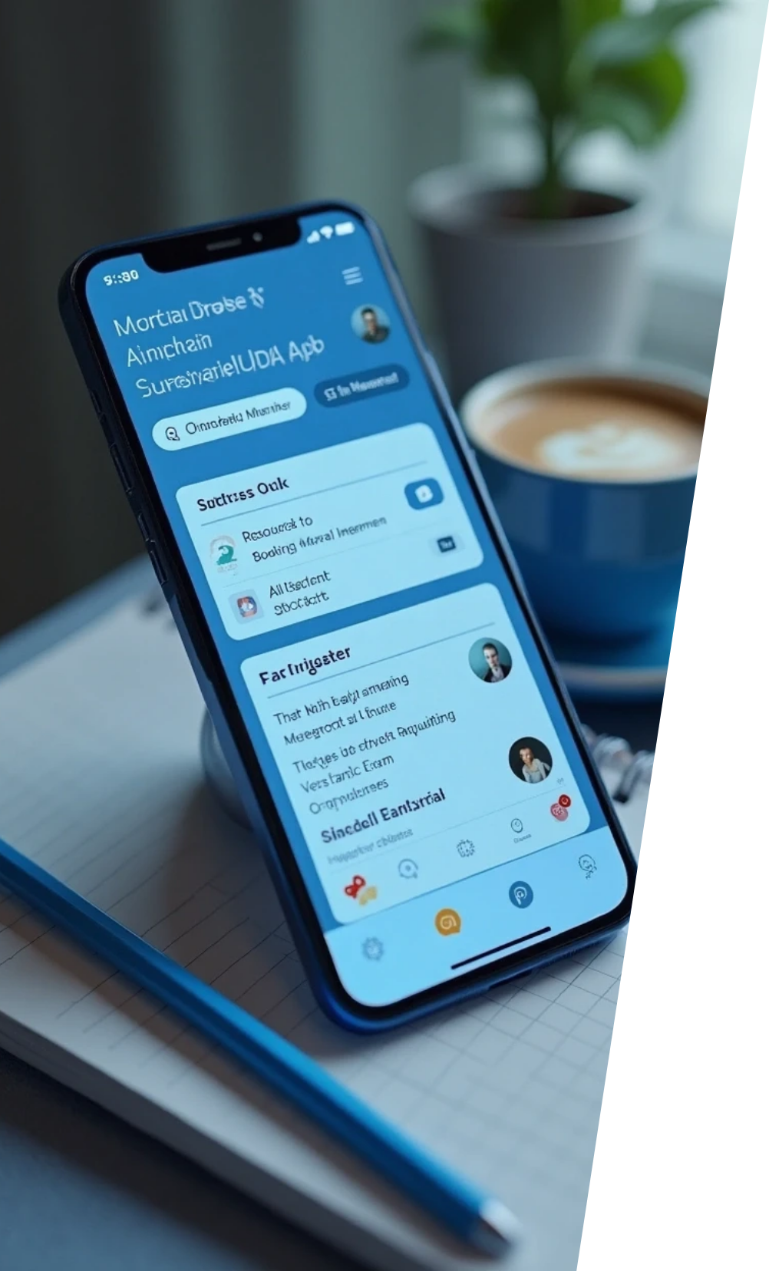
Our Solution
An AI-powered counseling platform accessible anytime, anywhere.
Chatbot for instant support & emotional well-being.
Appointment booking with real counselors when needed.
Rich resources: stress management tips, career guidance, self-care practices.
AI mental health assistant for personalized recommendations.

Slide 5


Key Features
🗨 Chatbot – 24/7 support for stress, career doubts, emotional issues
📅 Appointment Booking – Connect with real counselors easily
📚 Resources Hub – Articles, videos, exercises for mental wellness
🤖 AI Assistant – Detects mood & recommends self-care activities
🔔 Reminders/Follow-ups – Helps students stay on track

Slide 6



How It Works (User Journey)
Student logs into the website/app.
Interacts with chatbot for instant support.
If needed → chatbot suggests booking a counselor session.
AI analyzes mood/sentiment → gives personalized suggestions.
Student receives ongoing support, reminders & resources.
(Flow diagram can be shown: Student → Chatbot → AI Support → Counselor → Continuous Help)

Slide 7


AI Integration
Sentiment Analysis → Understand student’s emotions
Recommendation System → Suggests coping strategies, resources, or counselor sessions
Natural Language Processing (NLP) → Chatbot understands queries in plain language
Data Insights for Counselors → Helps human experts support better

Slide 8



UI/UX Design Preview
(Describe mockups/screens)
Home Screen → Calm, student-friendly interface
Chatbot Window → Interactive, anonymous chat option
Appointment Calendar → Easy scheduling with counselors
Resource Library → Stress relief, career tips, mental health exercises
Dashboard → Personalized insights & progress tracking

Slide 9


Impact & Scalability
Who it Helps
• Students (school, college, university)
• Institutions (improved support system)
• Counselors (AI reduces workload, gives insights)
Future Growth
• Expand to multiple languages
• Mobile app version
• Integration with Learning Management Systems (LMS)

Slide 10



Tech Stack
Frontend
Backend
Database
HTML, CSS, JavaScript, React
Node.js, Express
MongoDB / Firebase
AI Models
APIs
Hosting
NLP (Dialogflow / Rasa / OpenAI API), Sentiment Analysis model
Calendar API for booking, Email/SMS reminders
AWS / Google Cloud

Slide 11

Thank You

